Slide 1
DB#10 | Molecular lineage tracing of stem cell derived dopamine grafts
Petter Storm, Malin Åkerblom, Yu Zhang,, Tomas Björklund Malin Parmar
Developmental and regenerative Neurobiology, LUND UNIVERSITY

Slide 2
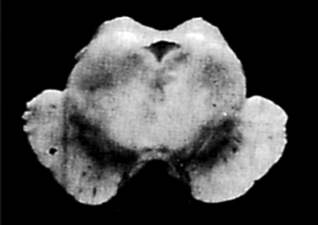
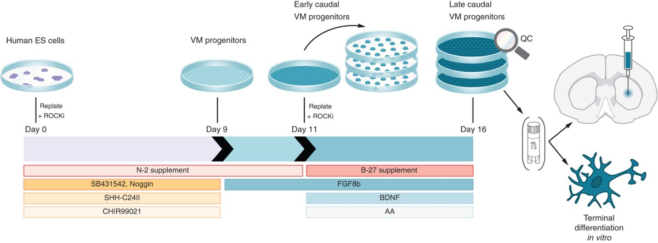
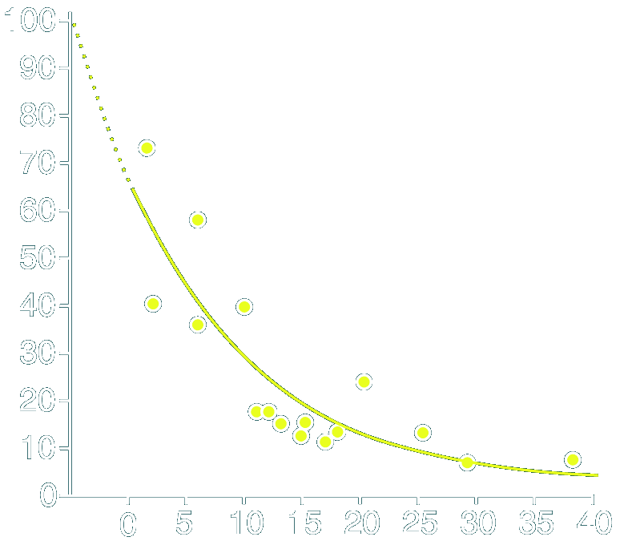
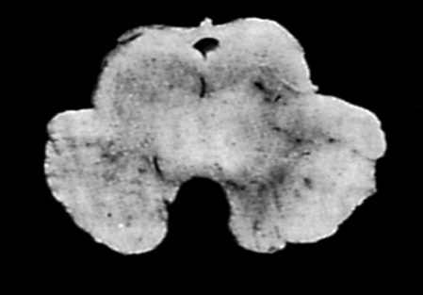
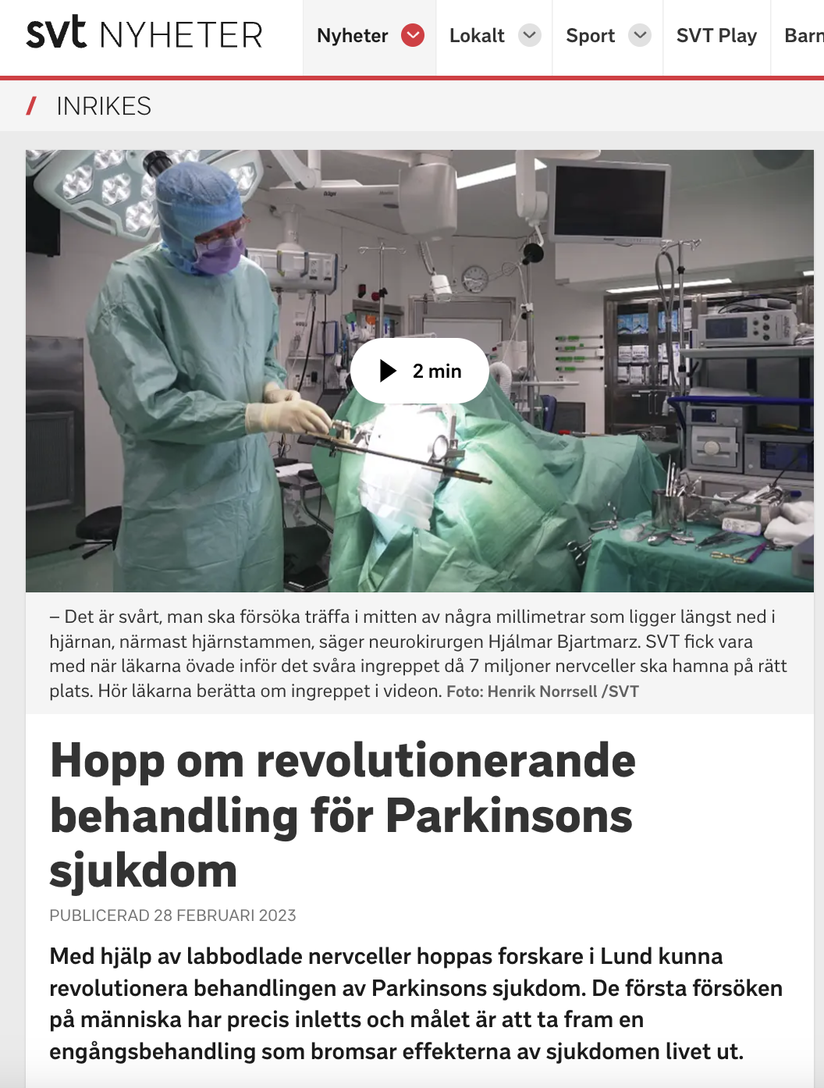

Replacing lost dopamine neurons in Parkinson’s disease with new ones
Parkinson’s disease is caused by the loss of dopamine neurons
Generation of dopamine progenitors from stem cells (2012)
Cells in Substantia Nigra (%)
Initiation of clinical trial (2023)
Time after diagnosis

Slide 3
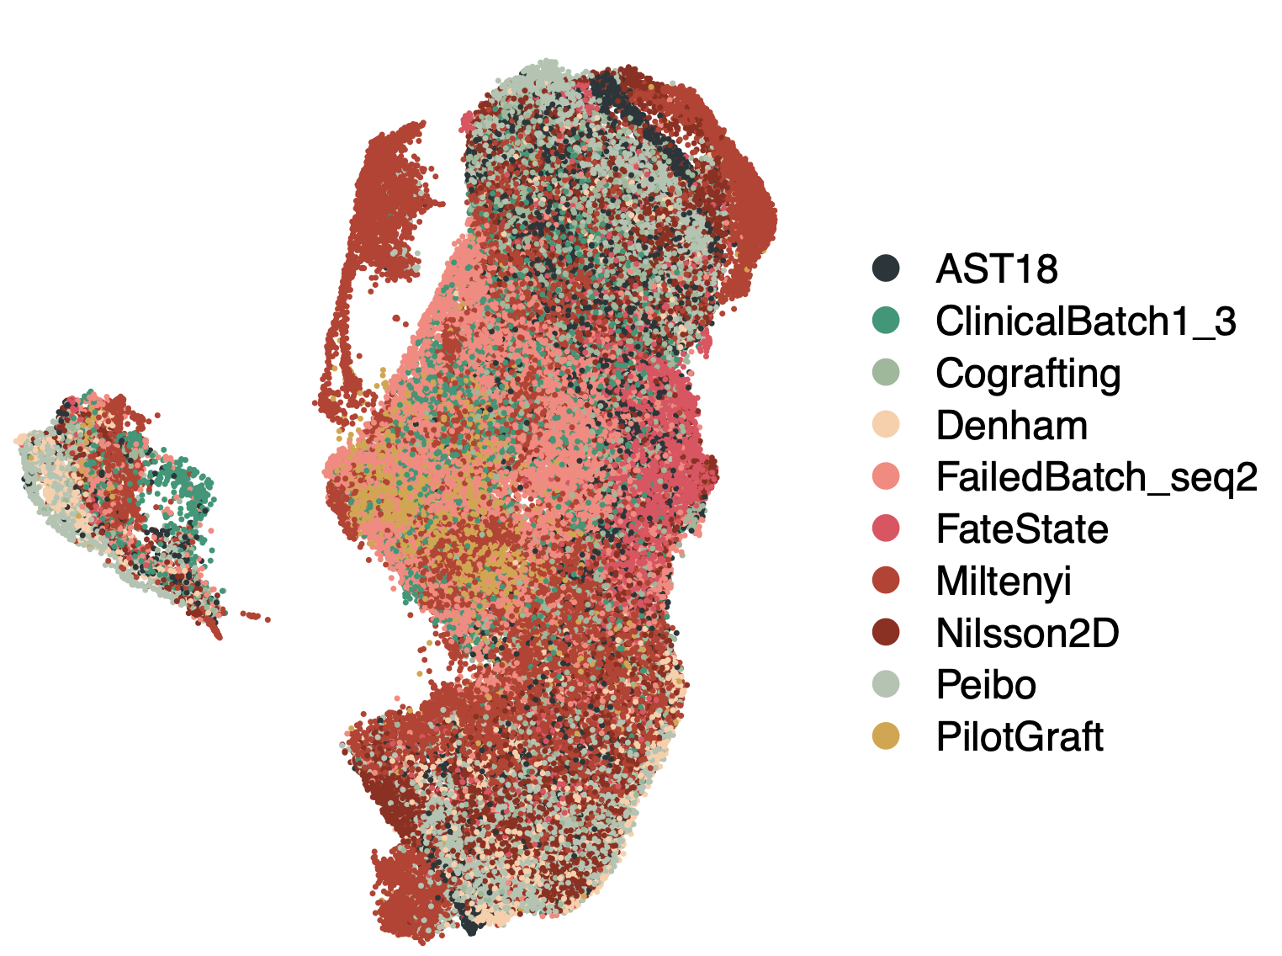
Progenitors are homogenous at time of transplantation
scRNA-seq day 16/18
UMAP latent space
sc/nRNA-seq day 16/18
Quantified homogeneity (ROGUE)
UMAP2
UMAP1

Slide 4
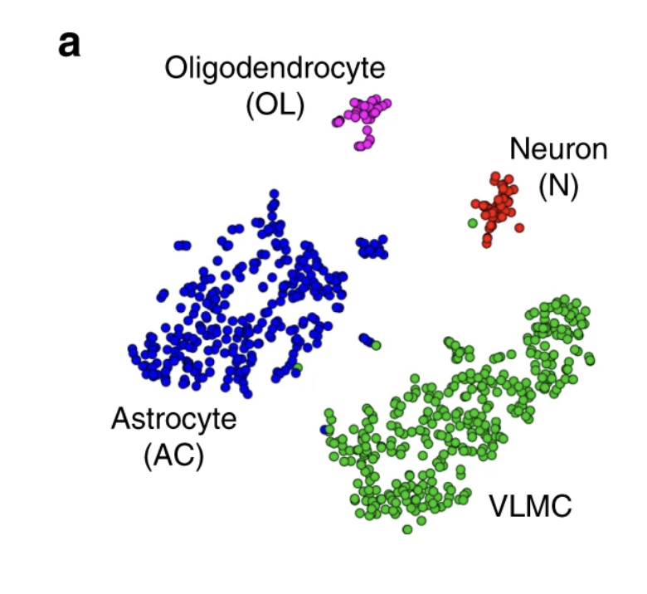
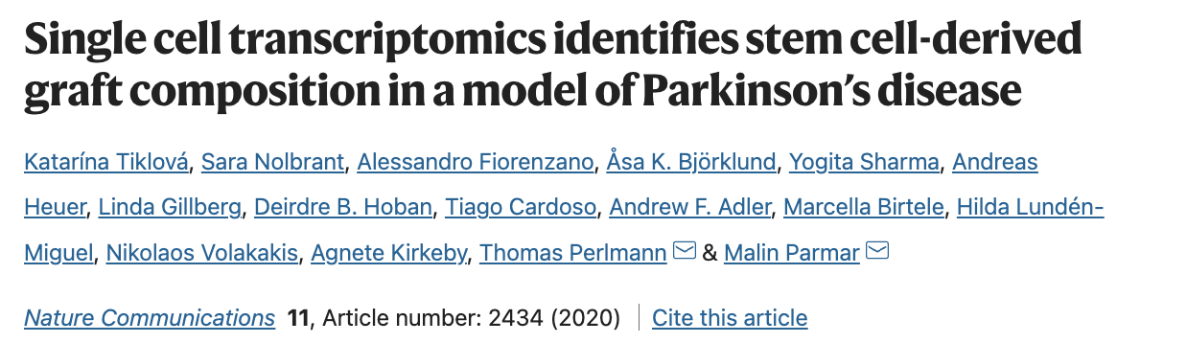
Progenitors are homogenous at time of transplantation – but gives rise to hetereogenous grafts!
sc/nRNA-seq day 16/18
UMAP latent space
sc/nRNA-seq day 16/18
Quantified homogeneity (ROGUE)
scRNA-seq – 6 months grafts
UMAP latent space
UMAP2
UMAP1

Slide 5
Homogenous progenitors give rise to heterogenous grafts – why?
Are progenitors truly homogeneous, or do lineage-restricted subtypes exist?
Can we modulate the cell therapy product to boost dopamine neuron yield?

Slide 6
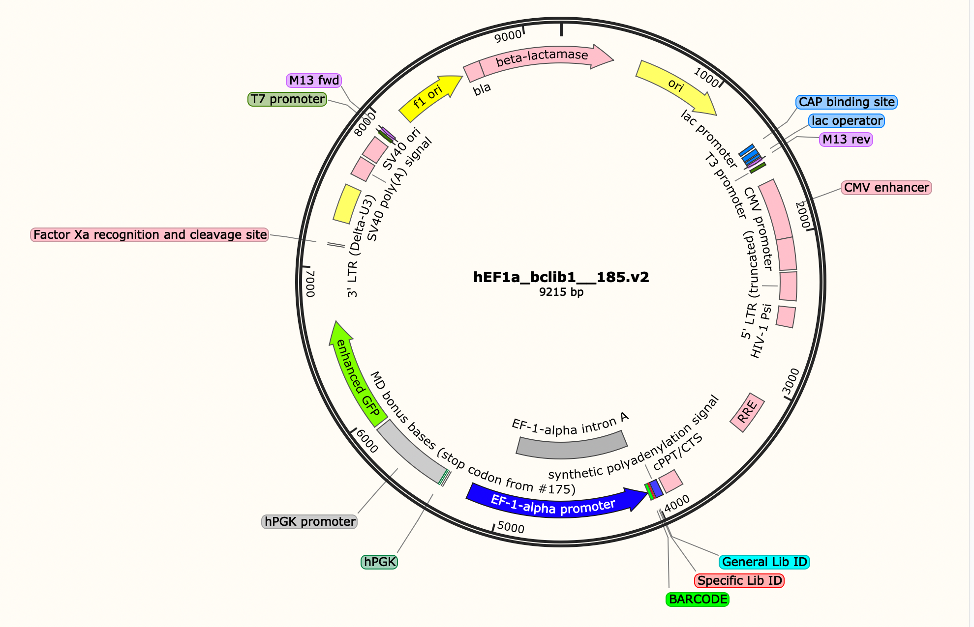
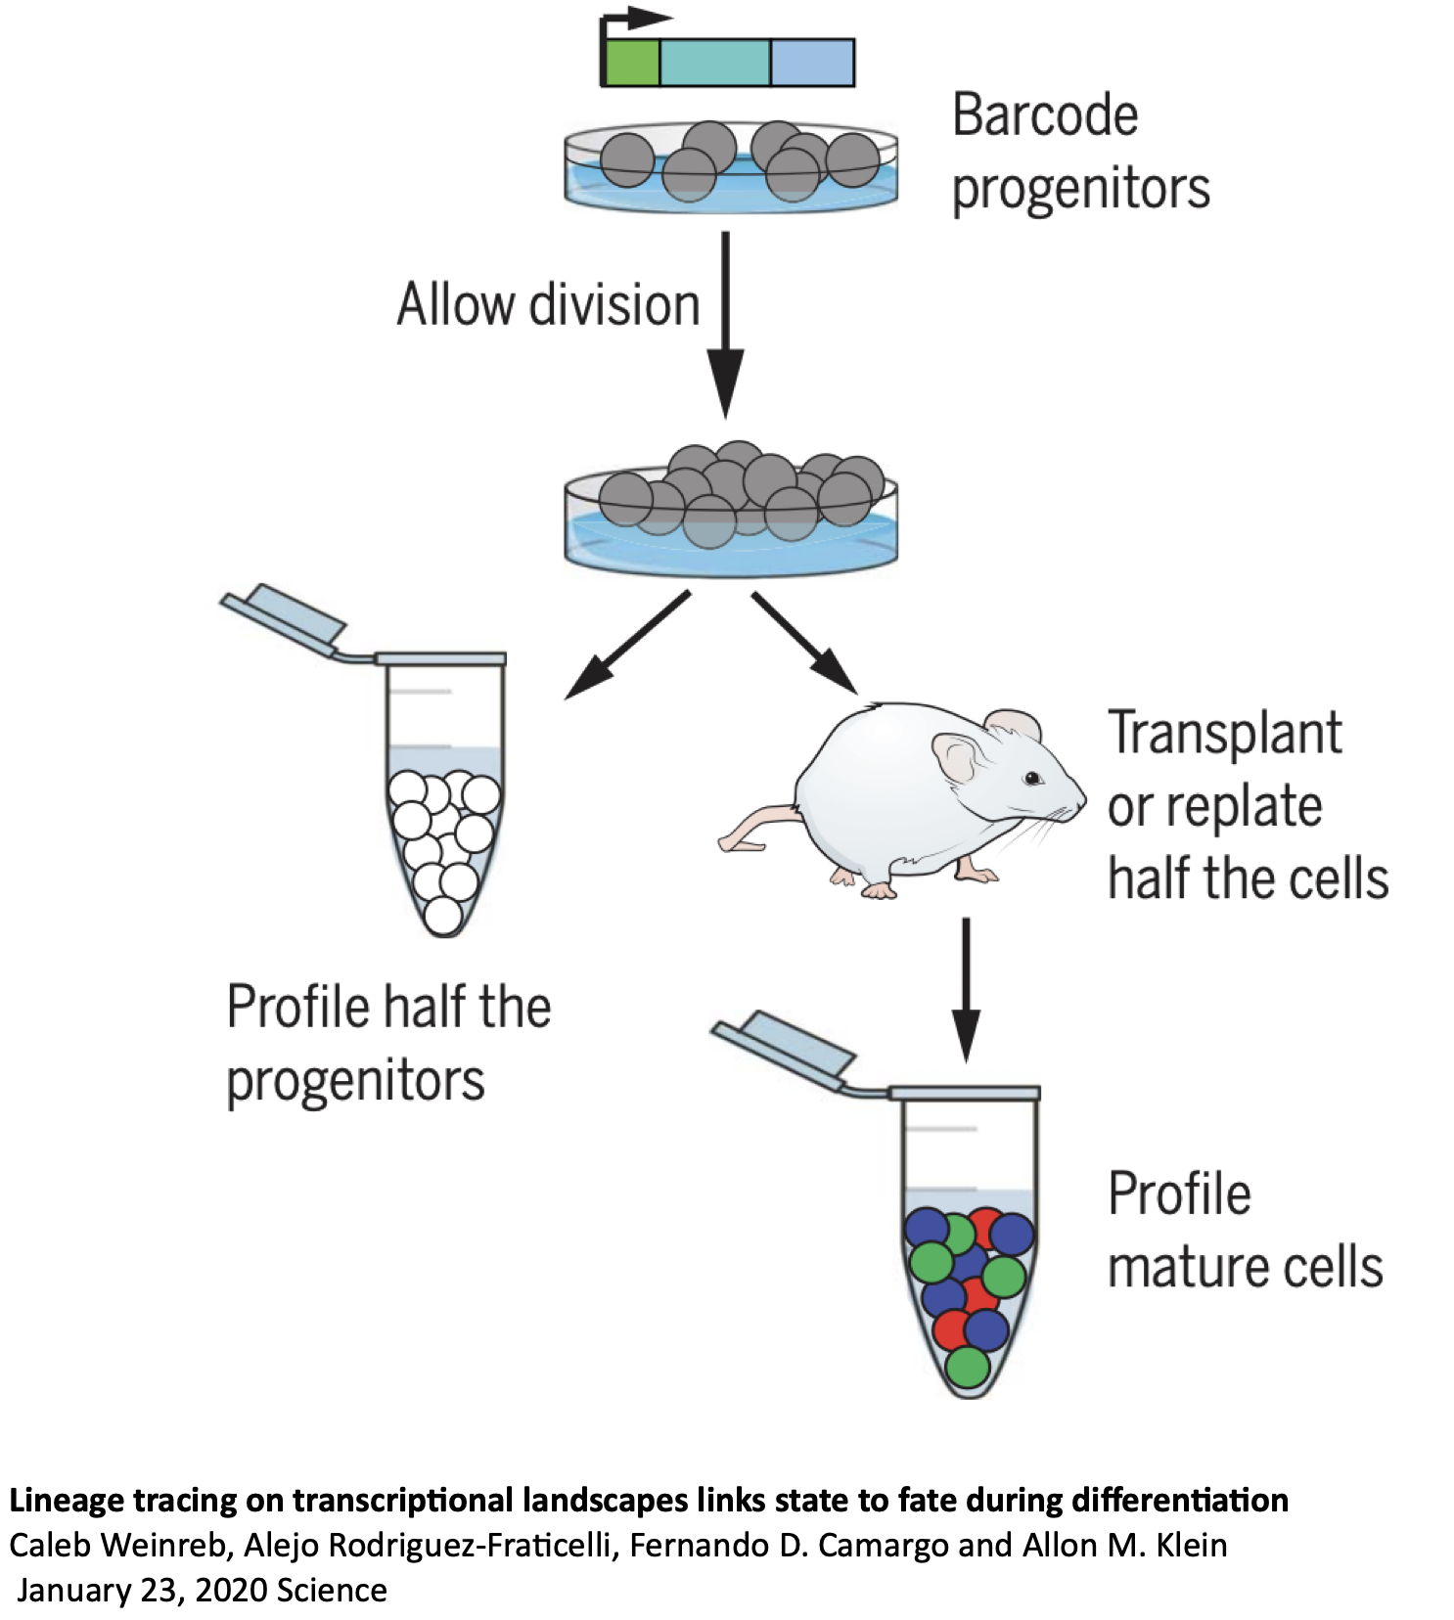
Molecular barcodes to trace and determine origin and shared lineages of hESC grafts
Notes:
Theoretically 10^12 barcodes
Integrated into the genome
Transcribed

Slide 7
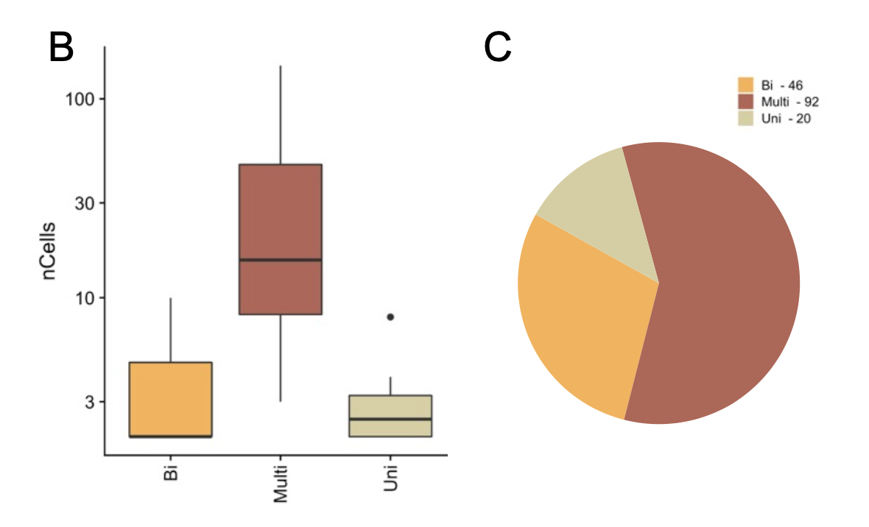
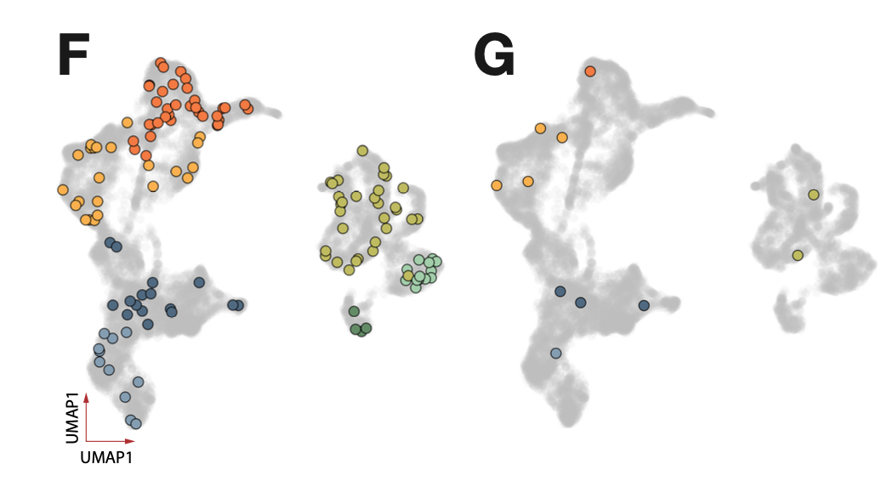
The majority of progenitors are multipotent at time of transplantation
CloneID: 57
CloneID: 12
Clone type distribution
Clone size
(# cells per clone type)
VLMC
Neurons
Astrocytes

Slide 8
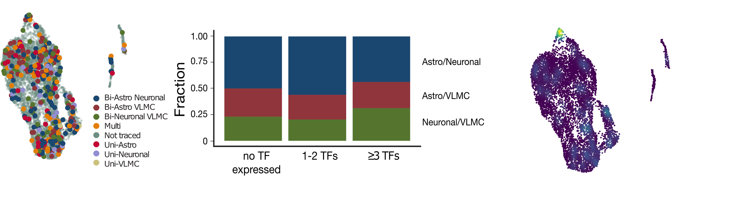
Transcriptome of transplanted progenitors does not explain potency
Expression of LMX1A/EN1/OTX2 and FOXA2
Neuro-biased progenitors cluster within the UMAP

Slide 9
Conclusion
Single cell lineage tracing allows us to associate molecular differences among progenitor cells with their capacity to generate mature cell types in vivo.
All mature cell types in the graft share a common progenitor with an undistinguishable transcriptional profile at day of grafting.
No apparent impurity or incorrectly specified progenitor population gives rise to VLMCs.

Slide 10
Acknowledgement
Team Parmar
Malin Parmar
Anders Björklund
Andreas Bruzelius
Jenny Nelander
Malin Åkerblom
Yogita Sharma
Alessandro Fiorenzano
Sara Corsi
María García Garrote
Jana Bonsberger
Kerstin Laurin
Bengt Mattson
Ulla Jarl
Michael Sparrenius
Jenny G Johansson
Linda Eliasson
Ronja Wagner

