Slide 1
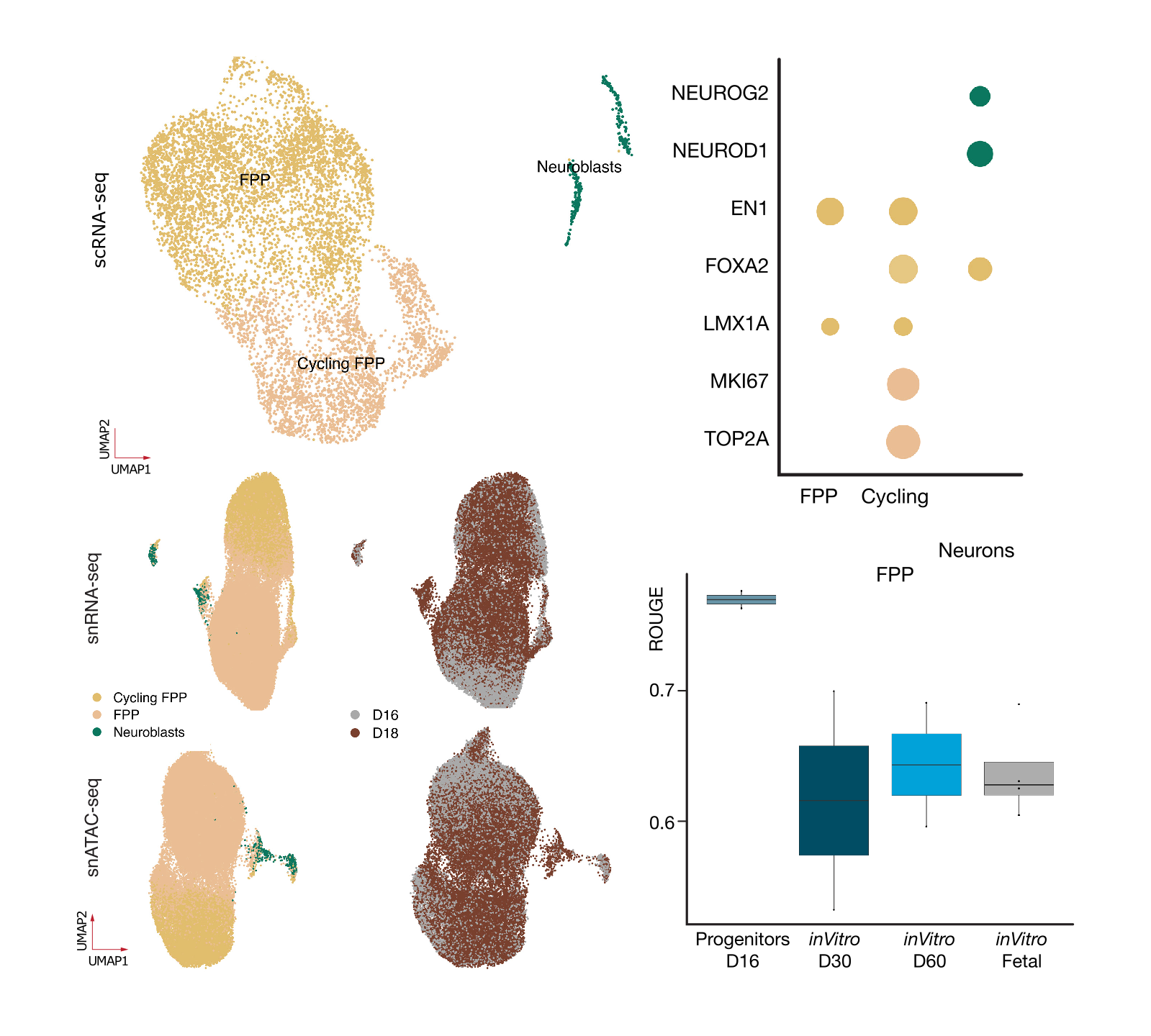
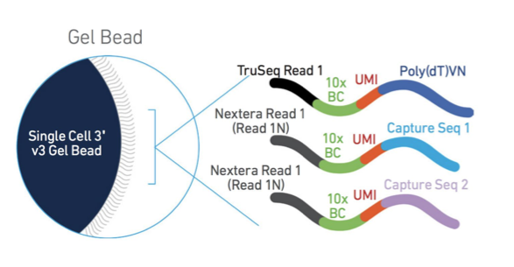
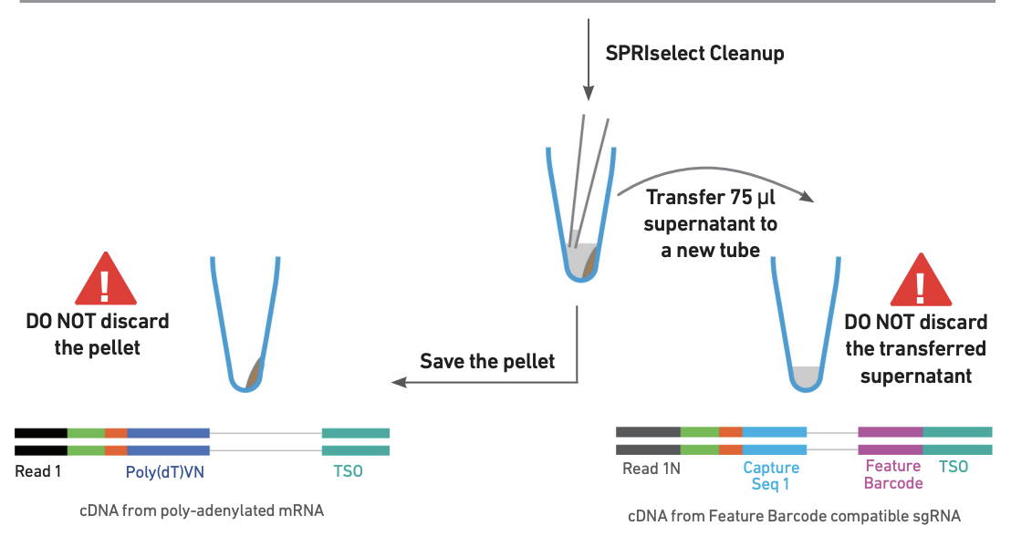
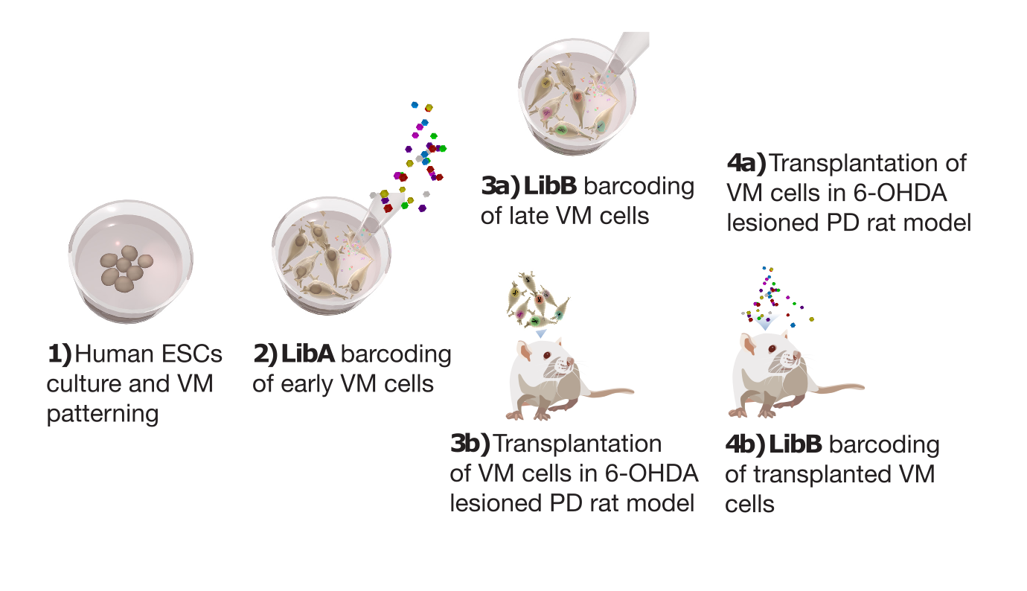
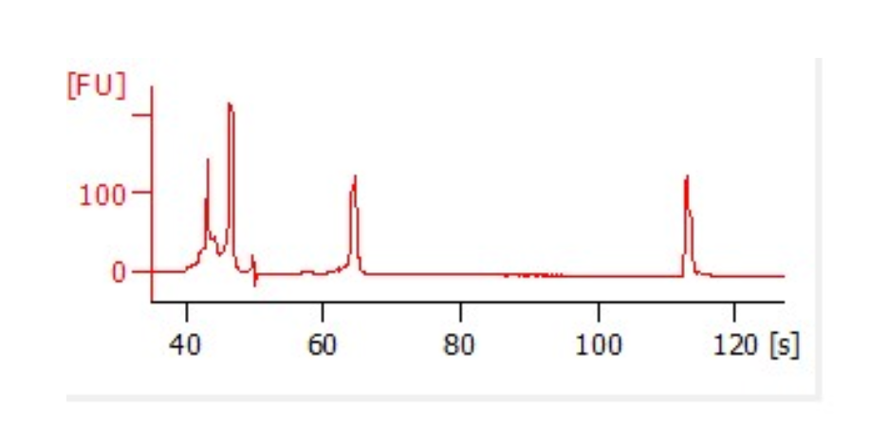
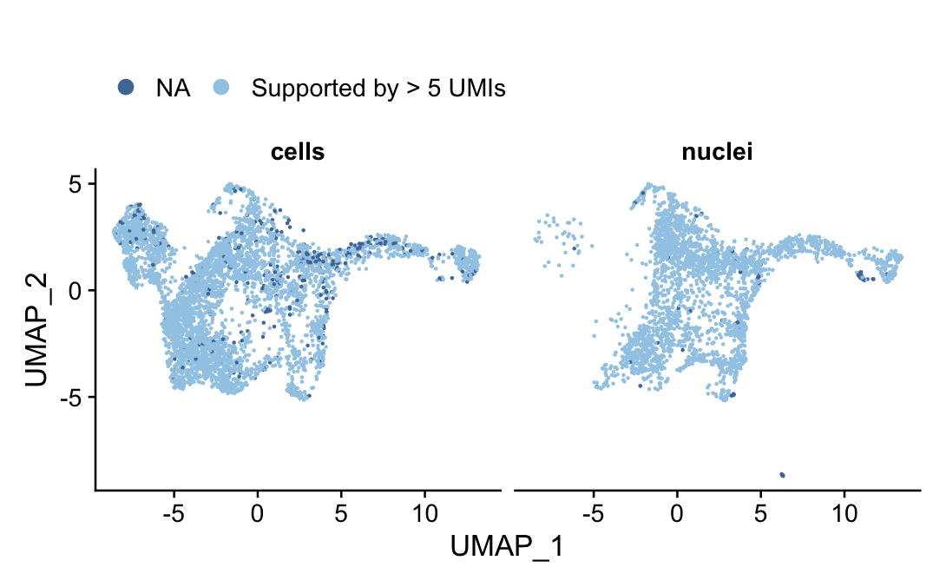
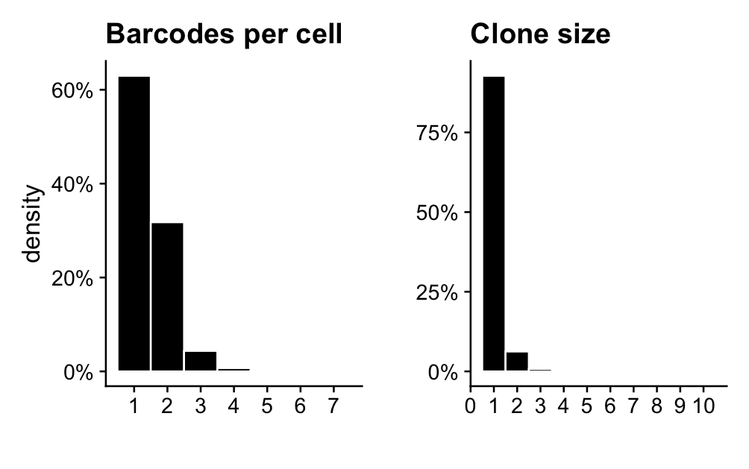
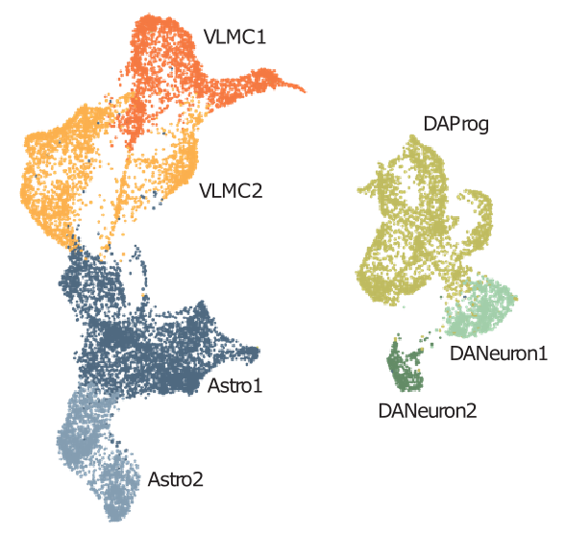
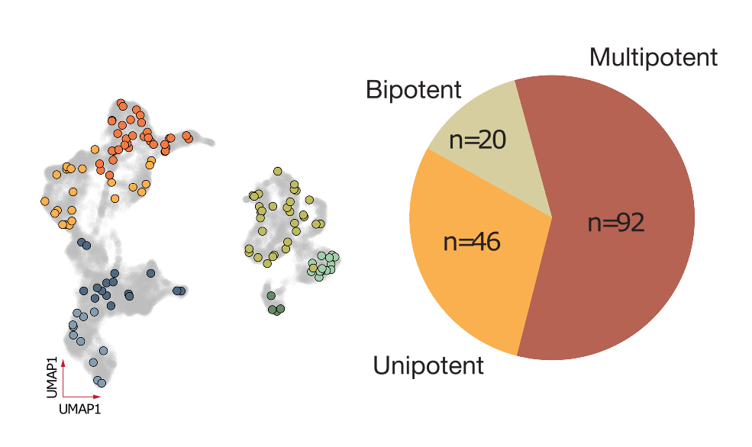
Molecular lineage tracing of stem cell derived dopamine grafts in vivo reveals shared origin of all graft derived cells
Petter Storm¹, Yu Zhang^{1,2,3}, MALIN ÅKERBLOM¹, Fredrik Nilsson¹, Alessandro Fiorenzano¹, EDOARDO SOZZI¹, Agnete Kirkeby^{2,3}, Tomas Björklund⁴, Malin Parmar¹
¹Developmental and Regenerative Neurobiology, Wallenberg Neuroscience Center, Lund Stem Cell Center, Department of Experimental Medical Science, Lund University, Sweden ²Department of Neuroscience, University of Copenhagen, Copenhagen, Denmark. ³Wallenberg Center for Molecular Medicine (WCMM) and Department of Experimental Medical Science, Lund University, Sweden. ⁴Molecular Neuromodulation, Wallenberg Neuroscience Center, Department of Experimental Medical Science, Lund University, Sweden
Background and aim
scRNA-seq profiling of hESC-derived grafts in in vivo models have revealed that seemingly homogenous cell preparations give rise to heterogenous grafts not only made up of dopamine neurons.
The methods used so far have not allowed inference of lineage relationships between the transplanted progenitors and the mature cells formed after delivery.
Here, we used single nuclei RNA-seq combined with molecular barcode tracing delivered to the progenitors both in vitro and in vivo to show that three cell types (neurons, astrocytes and vascular leptomeningeal cells, VLMCs) make up the cellular composition of the grafts and that they all share a common progenitor.
We also show preliminary data on a new barcode design with increased efficiency and capture without the need for PCR.
Multiomic characterization of ventral midbrain progenitors
A new barcode library for better efficiency
Midbrain progenitors were analyzed using scRNA-seq and found to be homogenous and forming three major clusters, floor plate progenitors (FPP), cycling FPPs and neuroblasts.
Homogeneity was quantified using ROGUE and confirmed with multiome analysis of chromatin accesibility and transcriptome.
Feature barcoding enables better capture off barcodes on 10X beads
Library construction from supernatant enables better capture of short transcripts
Very efficient recovery of barcodes from progenitors barcoded at day 18 and sequenced at day 22
Molecular barcoding in vivo and in vitro using lentiviral vectors
All cells were barcoded at day 11, then split into two and either barcoded at day 16 (in vitro) or four weeks after grafting.
Resulting grafts, as well as progenitors, were analyzed using snRNA-seq and histology at 3- and 6-months past grafting.
10X library from supernatant fraction contains almost only barcode reads
Library | Cells/ nuclei | % reads with barcode
cells | 4546 | 94%
nuclei | 2686 | 96%
Two different pooled lentiviral barcode libraries containing 20-bp long, random nucleotide sequences (molecular barcodes) that can be captured using snRNA-sequencing was used to lineage trace.
95% of cells/nuclei has at least one high confidence barcode (supporet by > 5 UMIs). Clone sizes is concordant with biology.
snRNA-seq of barcoded grafts confirms three major cell types
Example of multipotent clone
Conclusion
snRNA-seq of hPSC derived dopamine grafts confirms previous findings and shows that grafted cells differentiates into three main cell types.
Lineage tracing of progenitors barcoded at day 11 and day 16 shows that the great majority of cells are multipotent.
Day 16 progenitors are homogenous at the transcriptional and chromatin accsesibility level.
Barcoded progenitors gave rise to dopamine rich graft consisting of neurons, astrocytes and VLMC-cells in roughly equal proportions.
Clones from progenitors barcoded before transplantation were predominantly multipotent and ranging in size from 3-150 cells. Mulitpotent clones were larger than uni/bi-potent clones.
Contact
Petter Storm, petter.storm@med.luse
Malin Parmar, malin.parmar@med.lu.se

